Slide 1
Design - Data warehouse requirements, strategy, methodology.

Slide 2
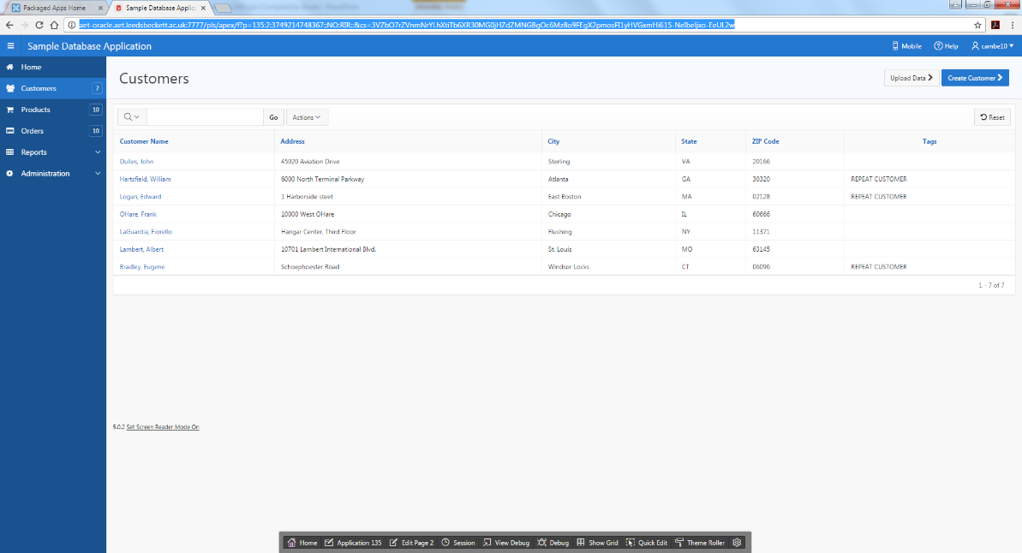
OLTP – Operational system
OLTP (on-line transaction processing)
  Major task of traditional relational DBMS
  Day-to-day operations: purchasing, inventory, banking, manufacturing, payroll, registration, accounting, etc.
  INSERT, UPDATE, DELETE
  Reports to help with day/week tasks
  Demo sample database

Slide 3
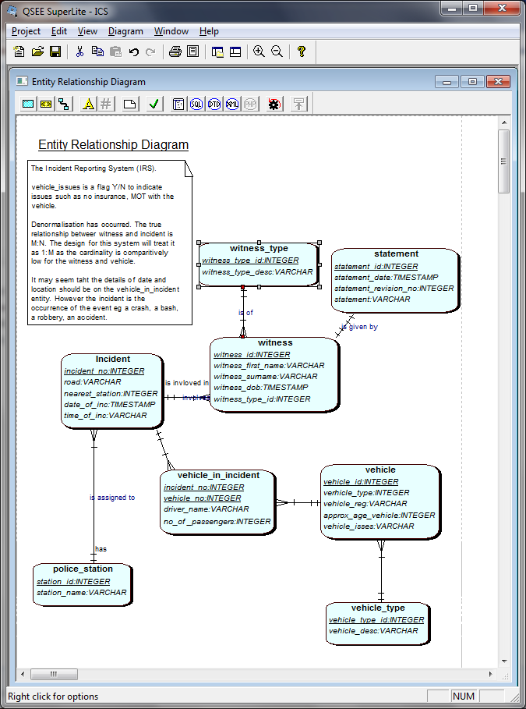
Notes:
Find out incidents today?
Incidents last year on the same day?
How many incidents person ??? Has been involved with?
How many incidents ever?

Slide 4
Looking at the Operational system
OLTP
What are the requirements of this system?
How many users for this system?
How significant is the speed of data retrieval?
How is data maintained?
When is data maintained?
What data models are used?
How much data is kept in the ‘operational system’?
How current is the data?
Do we/can we ‘delete’ data?
handout

Slide 5
Lets take a promotion ☺
As a business owner/ director / strategist/ head of global economic in the UK / business consultant
Direct, understand, provide strategy for the Company

Slide 6
Companies use their data to
Answer questions
Evaluate processes, understand their market, analyse trends

Slide 7
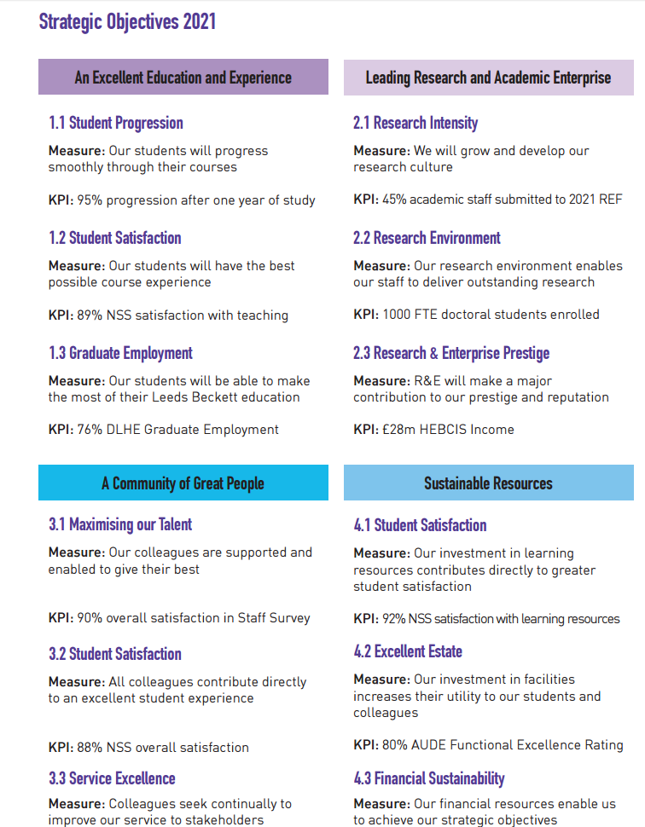

http://www.leedsbeckett.ac.uk/public-information/strategic-plan/

Slide 8
Looking at the Strategic Objectives (SO’s)
What are the requirements for the ‘data’ system to hold the information to system the SO’s?
How many users for this system?
How significant is the speed of data retrieval?
Is the data from an OLTP system?
How is data maintained?
When is data maintained?
How much data is kept in this ‘SO’?
How current is the data?
Do we/can we ‘delete’ data?

Slide 9
Looking at the Strategic Objectives (SO’s)
What are the requirements for the ‘data’ system to hold the information to system the SO’s?
How many users for this system?
How significant is the speed of data retrieval?
High level reports, not individual people/products.
Eg To provide year on year information on Student satisfaction.

Slide 10
Looking at the Strategic Objectives (SO’s)
Is the data from an OLTP system?
How is data maintained?
When is data maintained?
How much data is kept in this ‘SO’ system?
How current is the data?
Do we/can we ‘delete’ data?

Slide 11
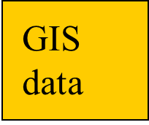
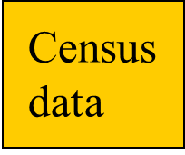
**
Data
Mining
Direct
Query
Reporting
tools
OLAP
Essbase
Intelligent Miner
SQL
Crystal reports
Merge
Clean
Summarize
Relational
DBMS+
Data warehouse
Detailed
transactional
data
ETL
Hong Kong branch
London branch
Beijing branch
Oracle
IMS
SAS
Operational data

Slide 12
“A data warehouse is a
subject-oriented,
integrated,
time-variant,
and nonvolatile collection of data in support of management’s decision-making process.”—W. H. Inmon
Check slides from DW-1

Slide 13
Decision support systems
Data base systems two types
  Transaction processing systems: OLTP
  Decision support systems: warehouses, OLAP, Mining
Historical data from OLTP systems form decision support systems
Goal: Learn from experiences in historical data
OLTP: many short, update intensive commands
Decision support: fewer, larger queries.

Slide 14
DW model options - Relational format
Needs to be restructured
For each report?
Could just have a massive spreadsheet …
Or a star schema
Or connections to all the other db (oltp) systems
Yuk

Slide 15
Dimensional Modelling
ER Techniques adopted
Fact Table
  Factual or quantitative data
  Generated by events
  Compound primary key
Dimension Tables
  Simple, non-composite Primary Key
  Descriptive
Notes:
Fact table will have attributes such as, quantity sold, orders made, products produced, appointments made.
The compound key is made up of the Foreign keys being the primary keys of the …
Dimension tables
Hold descriptive data about the subject.

Slide 16
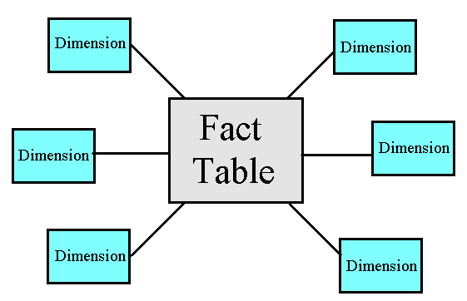
Star schema
A set of de-normalised DIMENSION tables giving DESCRIPTIONS, pointed at by:
One central FACT table containing numeric measures

Slide 17
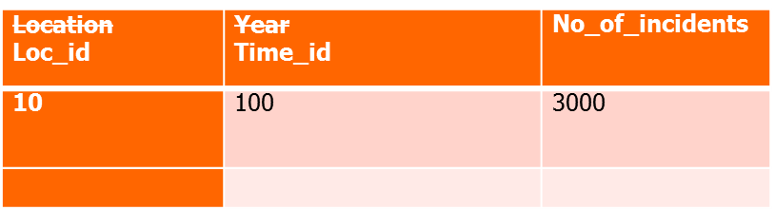
Star schema
location
Time_period
Loc_id | Loc_desc
10 | M62
11 | M1
time_id | time_desc
100 | 2002
110 | 2003
Fact_incidents

Slide 18
Identifying the sources
Understand user requirements
Understand the facts
Identify best source of dimension data
Map source to target
Notes:
Actually there is another step OR an underlying process which is occurring with these steps
Already talked about this a bit BUT
Users will often ask for financial or sales or inventory figures, but not mention customer details or product information because they usually see that with this type of data although it may not come from the same source.
i.e. supporting data sources they are unaware of.

Slide 19
Dimensional Model – Structure
OLTP Data
Data Warehouse
Relational OLAP Engine
OLAP Interface
OLTP
Fact &
Dimension
tables
Query
Processing
OLTP
Database Layer
Application Logic Layer
Presentation Layer

Slide 20
Benefits of the Dimensional Model
Simple structures for users to understand
Effective data extract achieved through the use of appropriate dimension tables
Aggregated data readily to hand
Drilling possible, as far as data allows
Well tried and understood tools available, both for extracting data and presentation

Slide 21
Problems of the Dimensional Model
Drill up/down is slow as requires access to other stars
Drill across and through not so easily understood by users.
Can be problems of scalability
Main point: Needs specific tools (eg better than Access!) if to run efficiently. Eg new forms of indexing of table rows.

Slide 22
Not the only Modeling method
For Analytical queries, Dimensional Modeling (Stars) is far more practical than querying the underlying Operational database

Slide 23
Bus Architecture
A collection of data marts designed for the enterprise

Slide 24
Data Warehouse, OLTP and OLAP
OLTP (on-line transaction processing)
  Major task of traditional relational DBMS
  Day-to-day operations: purchasing, inventory, banking, manufacturing, payroll, registration, accounting, etc.
OLAP (on-line analytical processing)
  Major task of data warehouse system
  Data analysis and decision making
Distinct features (OLTP vs. Data Warehouse):
  User and system orientation: customer vs. market
  Data contents: current, detailed vs. historical, consolidated
  Database design: ER + application vs. star schema + subject
  View: current, local vs. evolutionary, integrated
  Access patterns: update vs. read-only but complex queries

Slide 25
Why Separate Data Warehouse?
High performance for both systems
  DBMS— tuned for OLTP: access methods, indexing, concurrency control, recovery
  Warehouse—tuned for OLAP: complex OLAP queries, multidimensional view, consolidation.
Different functions and different data:
  missing data: Decision support requires historical data which operational DBs do not typically maintain
  data consolidation: DS requires consolidation (aggregation, summarization) of data from heterogeneous sources
  data quality: different sources typically use inconsistent data representations, codes and formats which have to be reconciled

Slide 26
Conclusions so far
Data Warehousing requires fast data retrieval
Data Warehousing is not concerned about how long it takes to store the data
A Star Schema is a data structure in which Data Warehouse Data can be stored to ensure efficient data retrieval
A Star Schema uses Dimension tables and Fact tables in data storage
A Data Warehouse can include a collection of Stars, each designed to meet selected business analytic queries.

Slide 27
Recap: What is Data Warehouse?
Defined in many different ways, but not rigorously.
  A decision support database that is maintained separately from the organization’s operational database
  Support information processing by providing a solid platform of consolidated, historical data for analysis.
“A data warehouse is a subject-oriented, integrated, time-variant, and nonvolatile collection of data in support of management’s decision-making process.”—W. H. Inmon
Data warehousing:
  The process of constructing and using data warehouses

Slide 28
Summary
DW is used for decision support, strategy
Project approach, methodology – largely SDLC
(see also CRISP), aspect of RAD, documentation.
Design starts with requirements, then ss model, data sourcing.
Implementation – creating ss db model, ETL
Reports (run on ss or extracted and loaded into OLAP tool).
Maintenance – of data, dimensions
Maintenance of new requirements, data marts

